Slide 1



View in Power BI

Slide 2
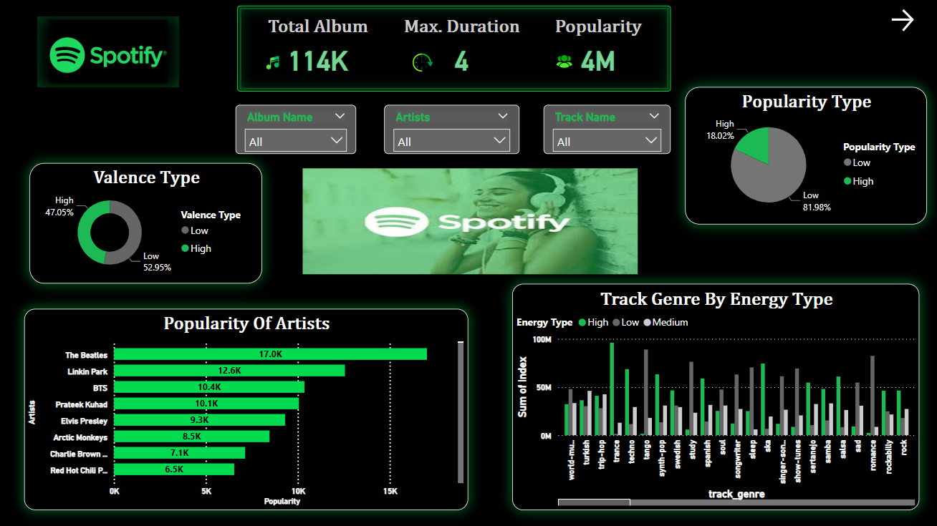

Slide 3
